Slide 1
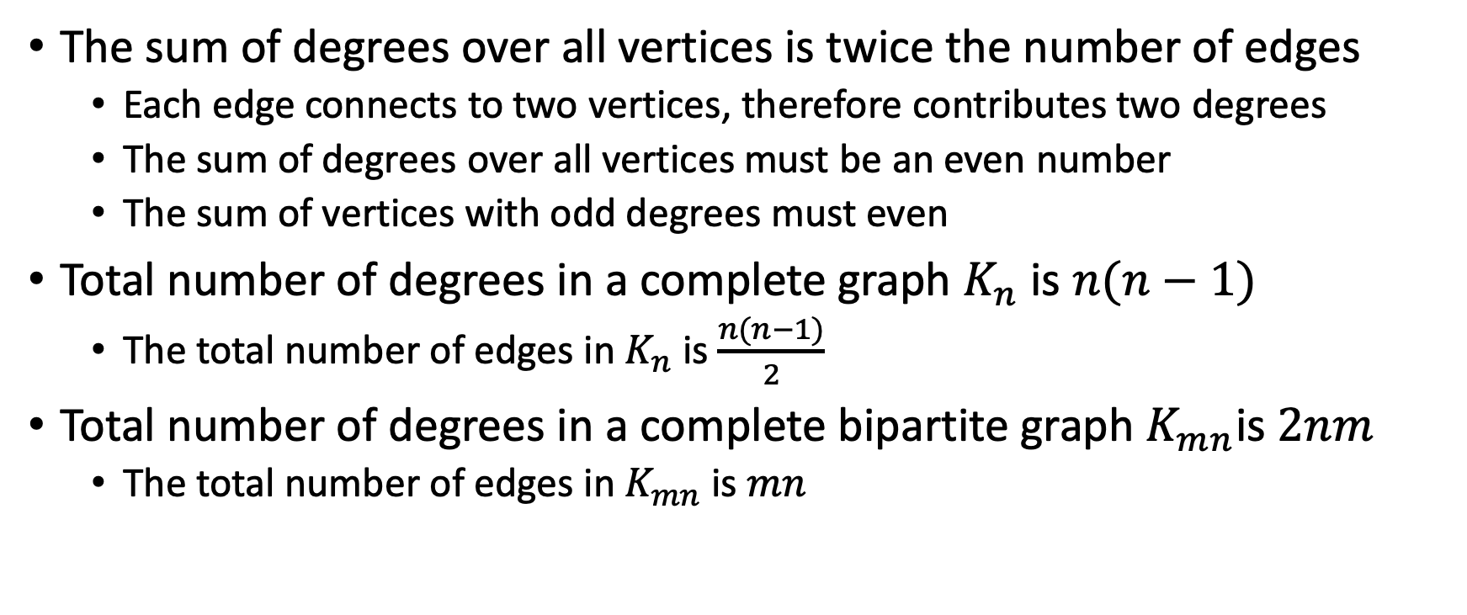
Edge Counting
The sum of degrees over all vertices is twice the number of edges
Each edge connects to two vertices, therefore contributes two degrees
The sum of degrees over all vertices must be an even number
The sum of vertices with odd degrees must even
Total number of degrees in a complete graph $K_{n}$ is $n(n−1)$
The total number of edges in $K_{n}$ is $\frac{n(n−1)}{2}$
Total number of degrees in a complete bipartite graph $K_{mn}$is $2nm$
The total number of edges in $K_{mn}$ is $mn$

Slide 2
Impossible graphs
Question:
In a party with 15 people, everyone knows exactly 5 people, is it possible?
In the same party, everyone is a stranger to exactly 5 people, is it possible?
The answer: from the graph theory, the total number of degrees in any graph must be even!
Should the number of people with odd number of siblings be even?
Should the number of parents with odd number of kids be even?
Consider this as a directed graph with directed edges from parents to children. The total number of out-degrees does not have to be even.

Slide 3
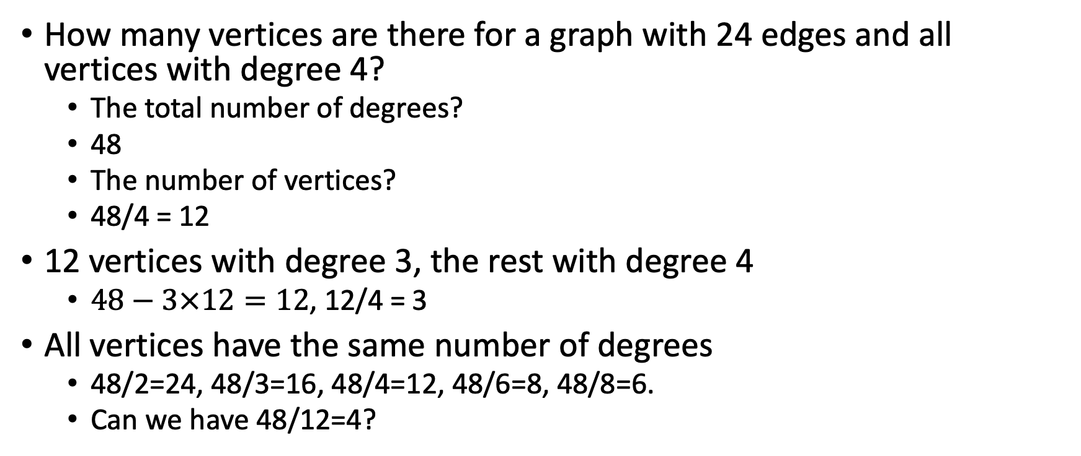
Some edge counting problems
How many vertices are there for a graph with 24 edges and all vertices with degree 4?
The total number of degrees?
48
The number of vertices?
48/4 = 12
12 vertices with degree 3, the rest with degree 4
$48−3×12=12$, 12/4 = 3
All vertices have the same number of degrees
48/2=24, 48/3=16, 48/4=12, 48/6=8, 48/8=6.
Can we have 48/12=4?

Slide 4

Some edge counting problems
What is the large number of vertices in a graph with 19 edges and all vertices of degree at least 3?
The total number of degrees is 38.
$3×12=36$
The rest two degrees could be distributed as (0,2), or (1,1).

Slide 5
Circuits in bipartite graph
A graph is bipartite if and only if all the circuit are even

Slide 6
Circuits in bipartite graph
A graph with no circuit is also bipartite

Slide 7
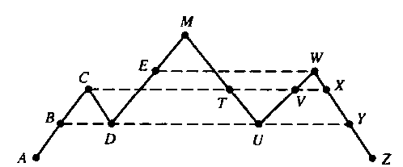
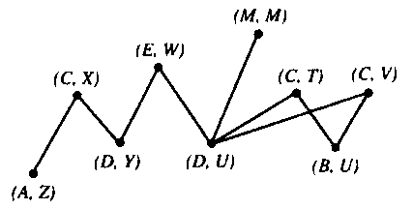
The Mountain Climbers Puzzle
Two people start at locations A and Z at the same elevation on opposite sides of a mountain range whose summit is labeled M. Is it possible for the two people to move along the range below to meet at M such that they are always at the same altitude every moment.
Always possible because (A,Z) and (M,M) are only degree 1, all others with even degree.

Slide 8
Planar Graphs
A graph is planar if it can be drawn on a plane without edges crossing. A planar depiction of a planar graph drawn or redrawn (isomorphically) with no crossing.
Plane graph of Figure 1
Figure 1
a
a b
e
f
e
c
d
b
d c
f

Slide 9
Circle-Chord Method (a method to determine if a graph is planar)
The circle-chord method:
Step 1: Find a circuit that contains all the vertices of the graph (draw it as a circle)
Note: Finding a circuit which includes all vertices is difficult.
Recall: circuit is a path that ends where it began
Step 2: The remaining non-circuit edges, called chords, must be drawn either inside or outside the circle without intersection.
If this is successful, the graph is planar
If there is a chord which cannot be drawn either inside or outside without intersection, the graph is non-planar

Slide 10

Example: $K_{33}$ is Nonplanar
indicates that the graph is a complete bipartite graph consisting of two sets of 3 vertices with each vertex in one set adjacent to all vertices in the other set.
1 3 5
2 4 6
1 3 5
2 4 6
1
6
2
5
3
4

Slide 11


Example: $K_{4}$is planar, ${ K}_{5}$ is Nonplanar
$K_{n}$ is a complete graph consisting of n vertices with each vertex is adjacent to all other vertices.
All $K_{n}, n>4$ is nonplanar.

Slide 12
Exercise: Is this graph planar?
a
Step 1:
Draw a circuit
f
b
e
c
d
a – b – e – d – c – f – a

Slide 13
Exercise (continued)
Step 2: Draw the circuit as a circle.
Step 3: Add the remaining edges.
a
a
f
f
b
b
c
e
e
c
d
d

Slide 14

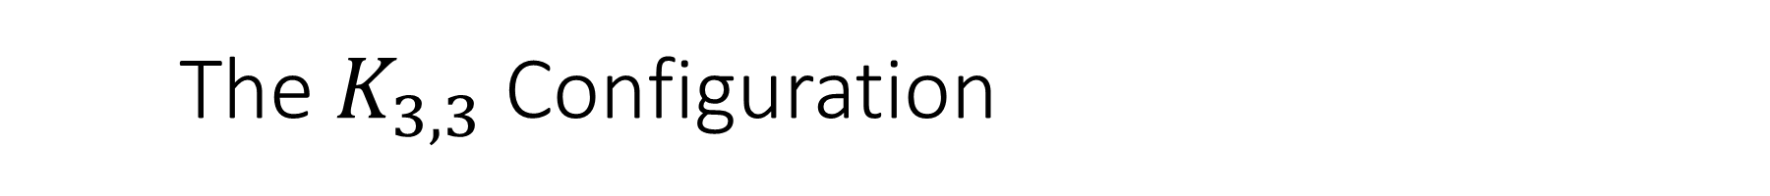
The $K_{3,3}$ Configuration
Note: A subgraph is a $K_{33}$ configuration if it can be obtained from a $K_{33}$ by adding vertices in the middle of some edges, or bifurcating vertices. A $K_{5}$ configuration is defined similarly.
Finding the configuration can be tricky.
1
6
2
5
3
4

Slide 15
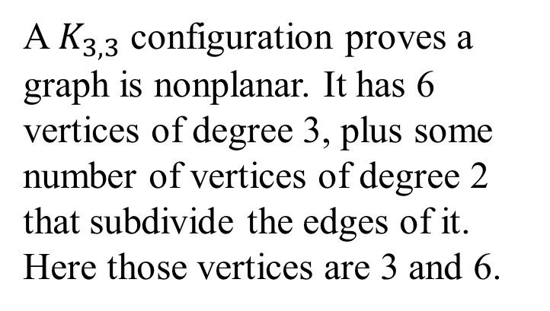

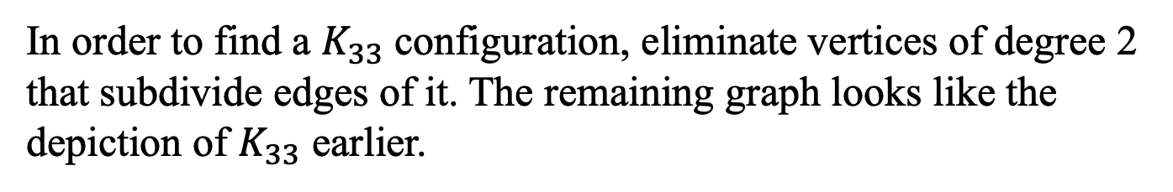
Example of a $K_{3,3}$ configuration
A $K_{3,3}$ configuration proves a graph is nonplanar. It has 6 vertices of degree 3, plus some number of vertices of degree 2 that subdivide the edges of it. Here those vertices are 3 and 6.
In order to find a $K_{33}$ configuration, eliminate vertices of degree 2 that subdivide edges of it. The remaining graph looks like the depiction of $K_{33}$ earlier.

Slide 16
Example
a b c d
e f g h
Step 1: Find a circuit. The orange highlights the circuit on this graph.
a
f
e
Draw this circuit as a circle.
c
b
h
g
d

Slide 17
a b c d
e f g h
Step 2: Choose a chord to draw, either inside or outside the circle. For example, we will start with the chord (b,f), drawing it outside the circle.
a
f
e
c
b
Since no lines cross another, this graph is planar!
h
g
d

Slide 18

Theorem (Kuratowski, 1930)
A graph is planar if and only if it does not contain a subgraph that is $K_{3,3}$ or $K_{5}$ configuration.
2
3
1
1
5
2
4
5
6
4
3

Slide 19

A $K_{5}$ configuration

Slide 20
Euler Formula
If G is a connected planar graph, then any plane graph depiction of G has r = e - v + 2 regions.
Recall: Connected planar graphs have paths between each pair of vertices.
v = number of vertices
e = number of edges
r = number of regions
There are many different plane graph depictions for a planar graph, however, the number of regions will not change.

Slide 21
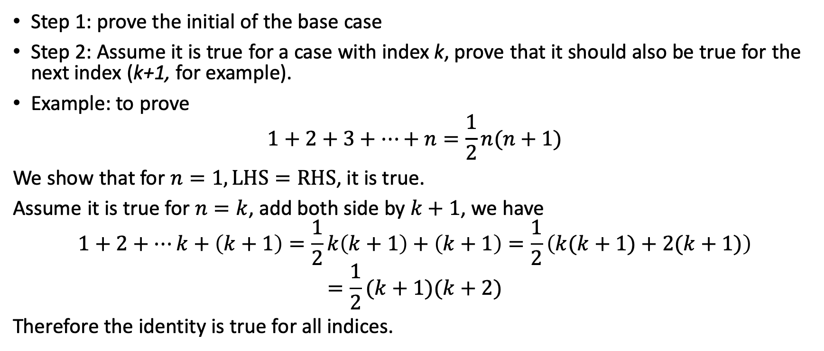
The method to prove Euler formula: Inductive method
Step 1: prove the initial of the base case
Step 2: Assume it is true for a case with index k, prove that it should also be true for the next index (k+1, for example).
Example: to prove
$$1+2+3+⋯+n=\frac{1}{2}n(n+1)$$
We show that for $n=1, LHS=RHS$, it is true.
Assume it is true for $n=k$, add both side by $k+1$, we have
$$1+2+⋯k+\left(k+1\right)=\frac{1}{2}k\left(k+1\right)+\left(k+1\right)=\frac{1}{2}\left(k(k+1)+2(k+1)\right)$$
$$=\frac{1}{2}(k+1)(k+2)$$
Therefore the identity is true for all indices.

Slide 22
x
y
y
x
Case 1: adding a vertex and an edge, region not changed.
Case 2: adding an edge to two existing vertices, regions will be incremented by 1.

Slide 23
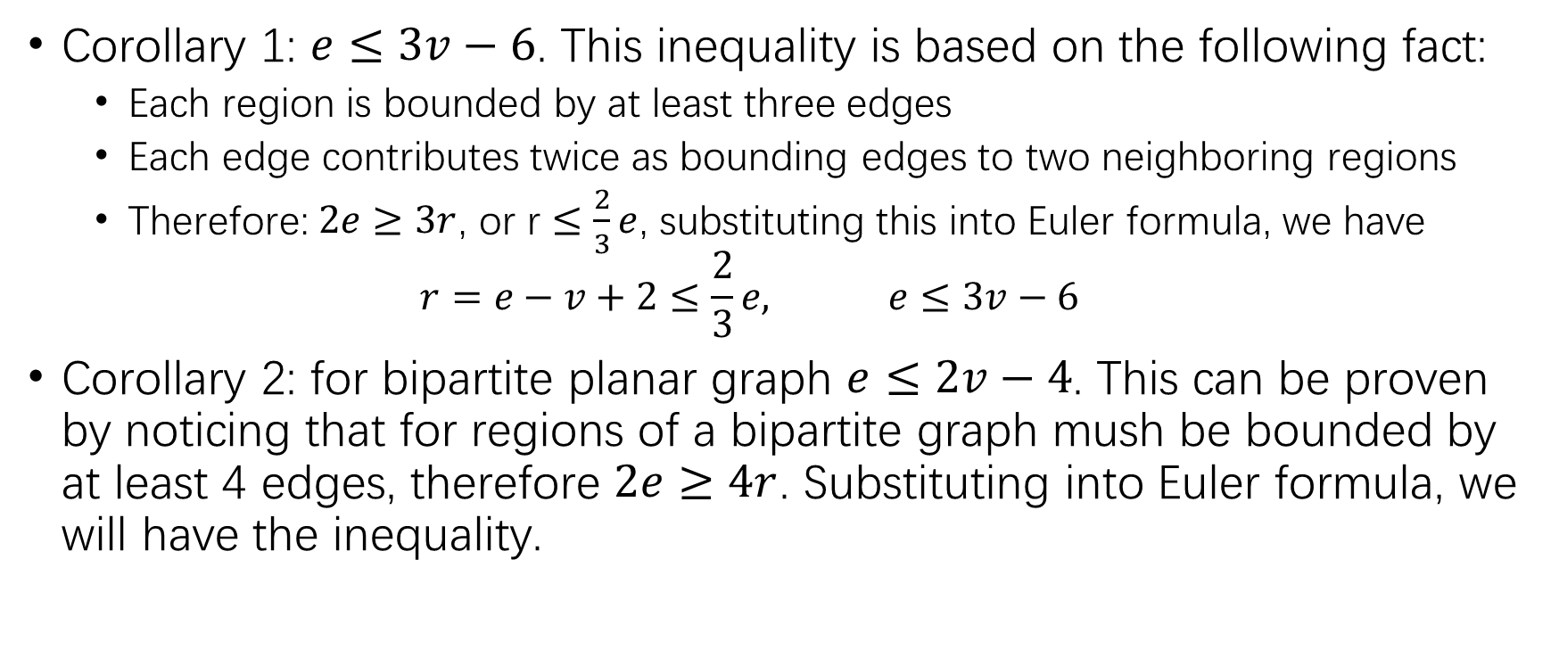
Corollaries of Euler formula
Corollary 1: $e≤3v−6$. This inequality is based on the following fact:
Each region is bounded by at least three edges
Each edge contributes twice as bounding edges to two neighboring regions
Therefore: $2e≥3r$, or r $≤\frac{2}{3}e$, substituting this into Euler formula, we have
$$r=e−v+2≤\frac{2}{3}e, e≤3v−6$$
Corollary 2: for bipartite planar graph $e≤2v−4$. This can be proven by noticing that for regions of a bipartite graph mush be bounded by at least 4 edges, therefore $2e≥4r$. Substituting into Euler formula, we will have the inequality.

Slide 24
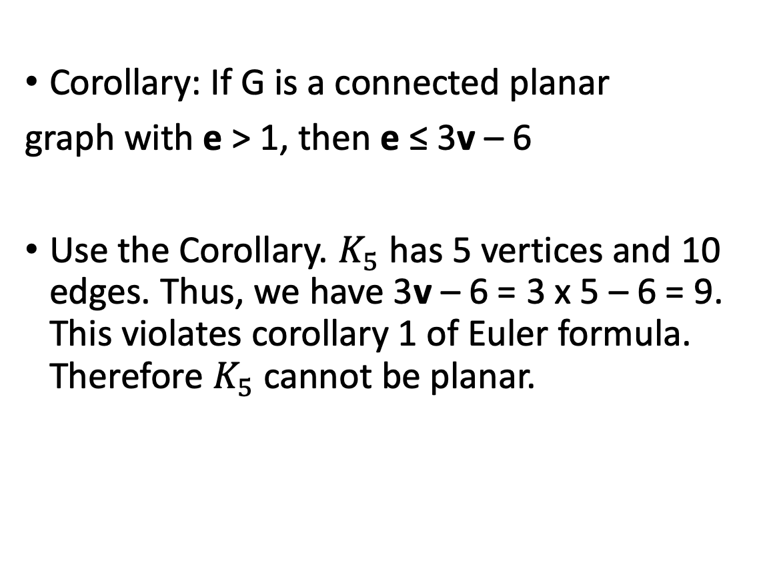

Example: $K_{5}$ cannot be planar
Corollary: If G is a connected planar
graph with e > 1, then e ≤ 3v – 6
Use the Corollary. $K_{5}$ has 5 vertices and 10 edges. Thus, we have 3v – 6 = 3 x 5 – 6 = 9. This violates corollary 1 of Euler formula. Therefore $K_{5}$ cannot be planar.

Slide 25
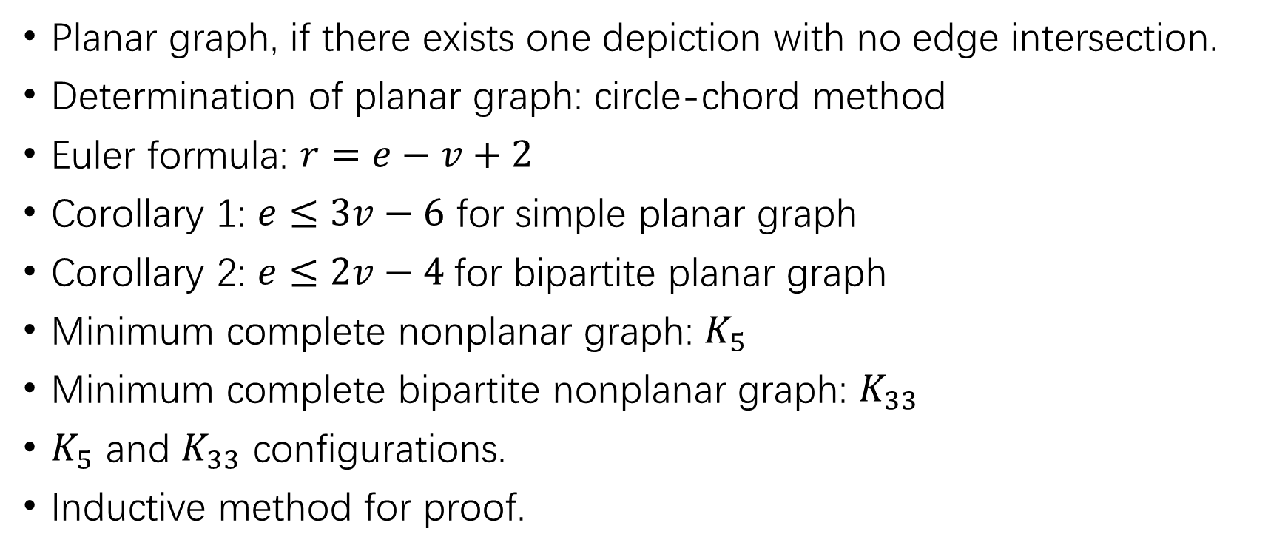
Summary of previous class
Planar graph, if there exists one depiction with no edge intersection.
Determination of planar graph: circle-chord method
Euler formula: $r=e−v+2$
Corollary 1: $e≤3v−6$ for simple planar graph
Corollary 2: $e≤2v−4$for bipartite planar graph
Minimum complete nonplanar graph: $K_{5}$
Minimum complete bipartite nonplanar graph: $K_{33}$
$K_{5}$ and $K_{33}$ configurations.
Inductive method for proof.

Slide 26
Is the following graph planar?

Slide 27
Is the following graph planar?

Slide 28
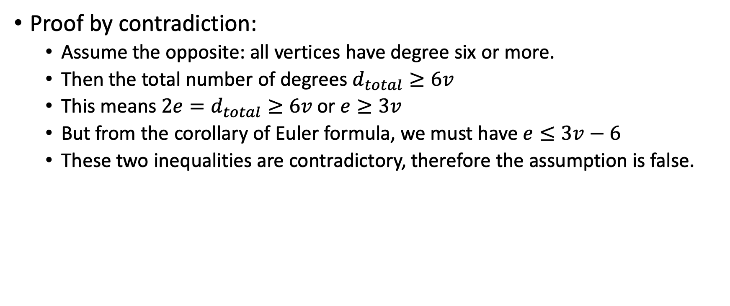
Theorem: every connected planar graph has at least one vertex with degree five or less.
Proof by contradiction:
Assume the opposite: all vertices have degree six or more.
Then the total number of degrees $d_{total}≥6v$
This means $2e=d_{total}≥6v$ or $e≥3v$
But from the corollary of Euler formula, we must have $e≤3v−6$
These two inequalities are contradictory, therefore the assumption is false.

